Slide 1
ANALYSIS OF RESIDUALS Patients with diabetes readmitted within 30 days
Neeraj Kumar Reddy Panta
Ruchi Dilip Kukde

Slide 2
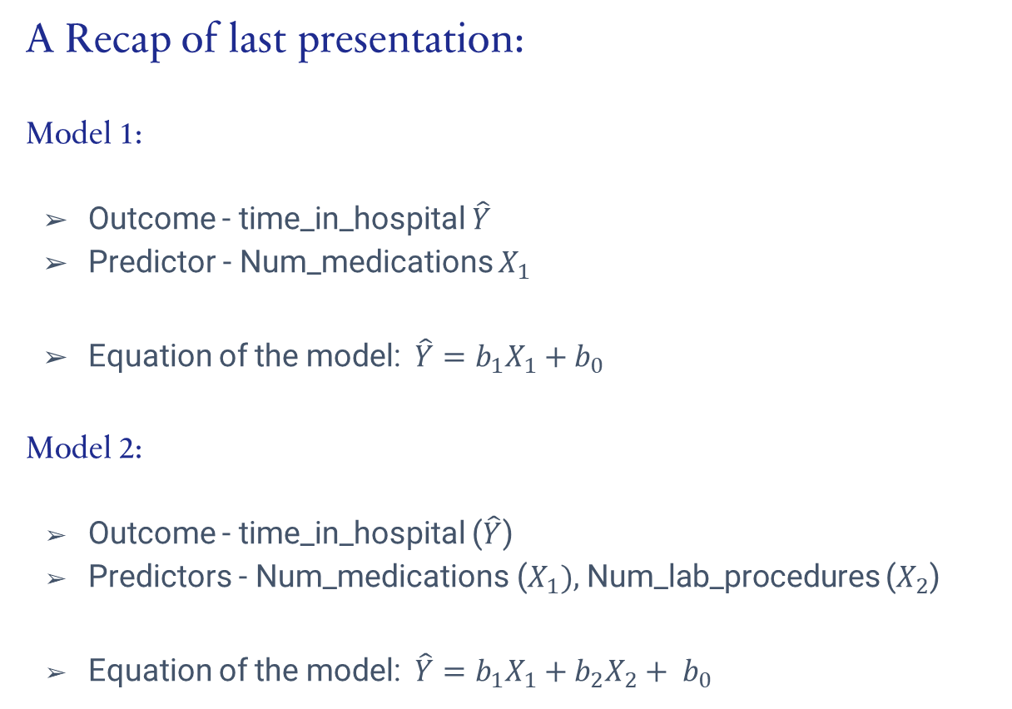
Linear Regression
A Recap of last presentation:
Model 1:
Outcome - time_in_hospital $\hat{Y}$
Predictor - Num_medications $X_{1}$
Equation of the model:$\hat{Y}=b_{1}X_{1}+b_{0}$
Model 2:
Outcome - time_in_hospital ($\hat{Y}$)
Predictors - Num_medications ($X_{1}),$Num_lab_procedures ($X_{2}$)
Equation of the model:$\hat{Y}=b_{1}X_{1}+b_{2}X_{2}+ b_{0}$

Slide 3
GAUSS MARKOV THEOREM MODEL 1
Verify conditions of

Slide 4
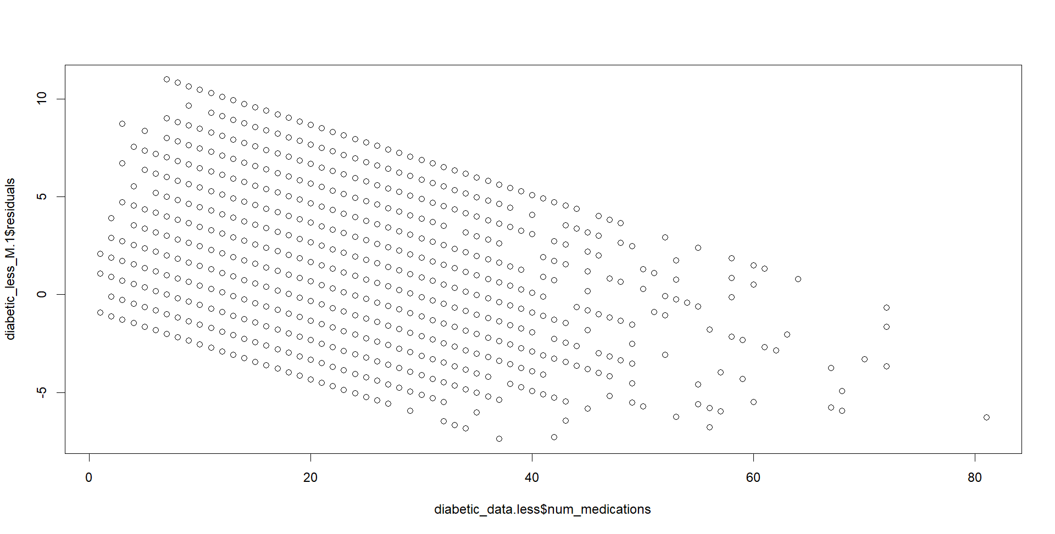
Residual plot for Model 1

Slide 5
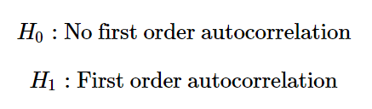
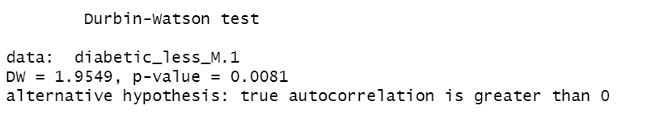
ANALYSIS OF RESIDUALS FOR Model 1
For model 1, we compute mean of the residuals.
Mean value of the residuals: -3.671336e-16
Therefore, the first condition that errors have expectation zero is satisfied.
Next, we have to test that the residuals are not correlated among themselves.
We use Durbin Watson Test:
Based on the low p-value we reject null hypothesis.
We conclude that the residuals are correlated with each other.

Slide 6
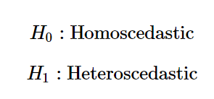
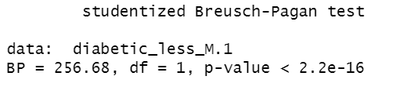
ANALYSIS OF RESIDUALS FOR Model 1 (contd.)
We perform Breusch-Pagan test to see if the homoscedasticity condition is satisfied or not.
Based on the small p-value we reject the hypothesis that residuals are homoscedastic. We conclude that the errors do not have equal variances.

Slide 7
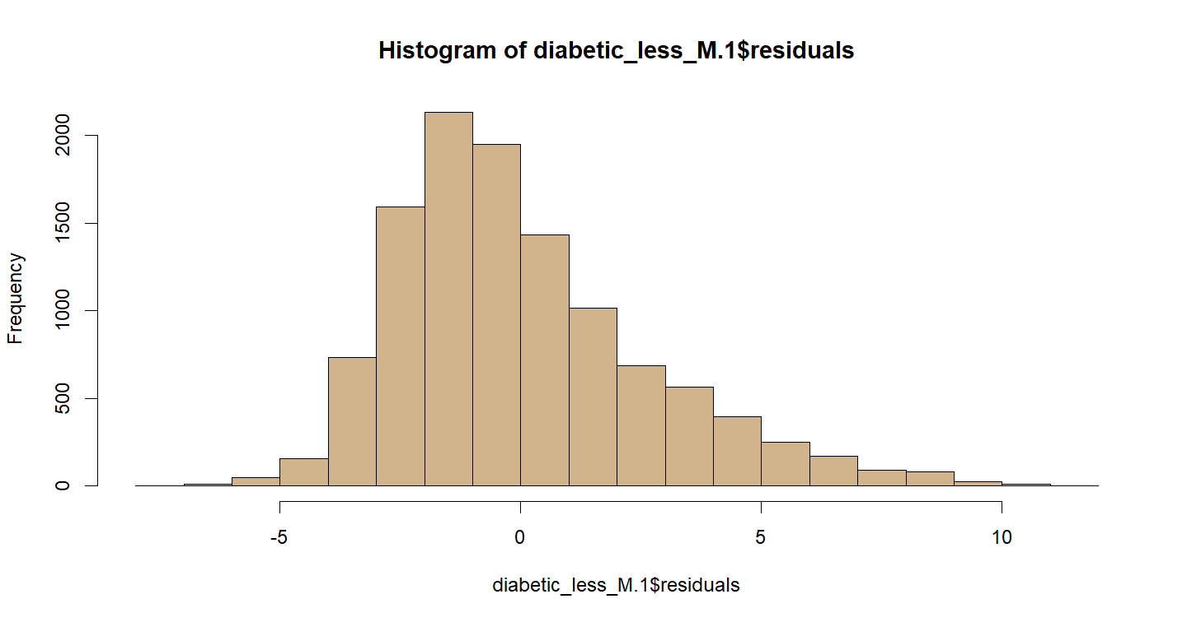
ANALYSIS OF RESIDUALS FOR Model 1 (contd.)
We test for normality of the residuals. We observe that the distribution of errors is right skewed. Therefore, normality condition is not satisfied.

Slide 8
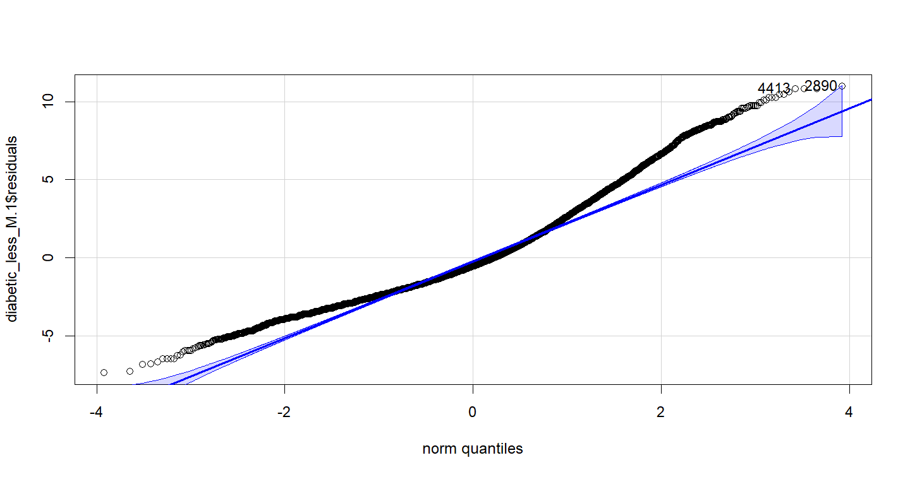
ANALYSIS OF RESIDUALS FOR Model 1 (contd.)
We test for normality of the residuals using qq-plot.
BUT!!! TOO MANY SAMPLES!!!
Normality condition is not satisfied.

Slide 9
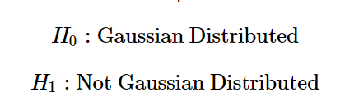


ANALYSIS OF RESIDUALS FOR Model 1 (contd.)
Formal test for normality Shapiro-Wilk test:
TOO MANY SAMPLES!!!

Slide 10
GAUSS MARKOV THEOREM MODEL 2
Verify conditions of

Slide 11
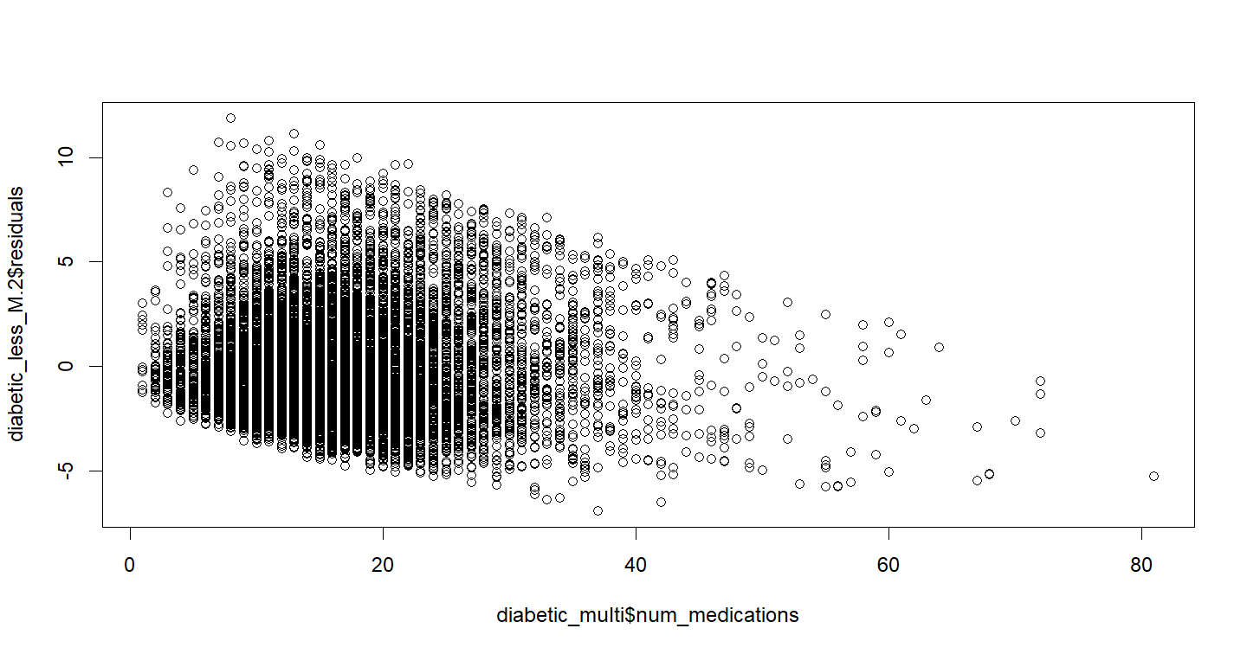
Residual plot for Model 2 Predictor: Number of medications

Slide 12
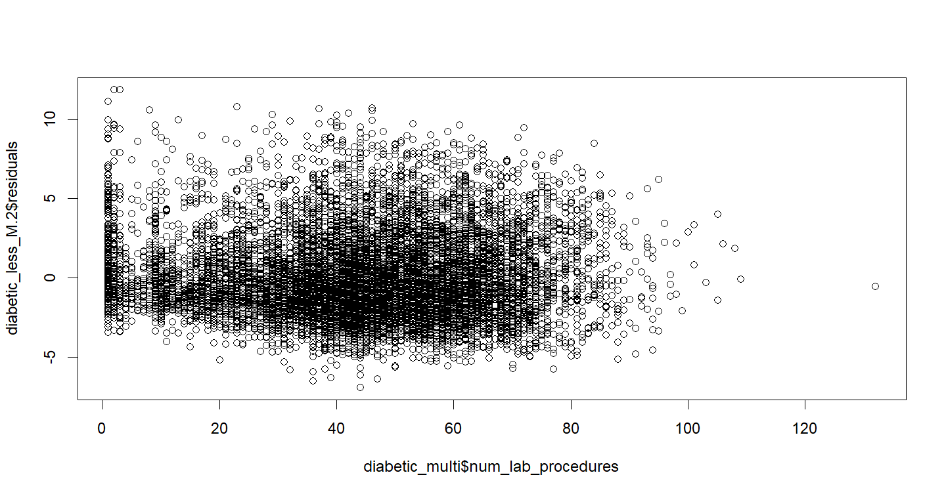
Residual plot for Model 2 Predictor: Number of LAB PROCEDURES

Slide 13
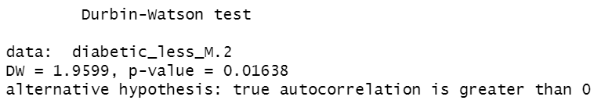
ANALYSIS OF RESIDUALS FOR Model 2
For model 2, we compute mean of the residuals.
Mean value of the residuals: 5.223827e-16
Therefore, the first condition that errors have expectation zero is satisfied.
Next, we have to test that the residuals are not correlated among themselves.
We use Durbin Watson Test:
Based on the low p-value we reject null hypothesis.
We conclude that the residuals are correlated with each other.

Slide 14
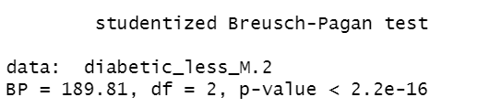
ANALYSIS OF RESIDUALS FOR Model 2 (contd.)
We perform Breusch-Pagan test to see if the homoscedasticity condition is satisfied or not.
Based on the small p-value we reject the hypothesis that residuals are homoscedastic. We conclude that the errors do not have equal variances.

Slide 15
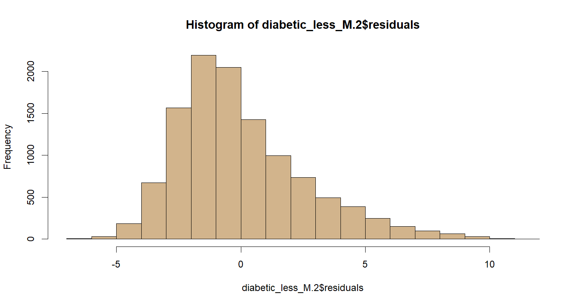
ANALYSIS OF RESIDUALS FOR Model 2 (contd.)
We test for normality of the residuals. We observe that the distribution of errors is right skewed. Therefore, normality condition is not satisfied.

Slide 16
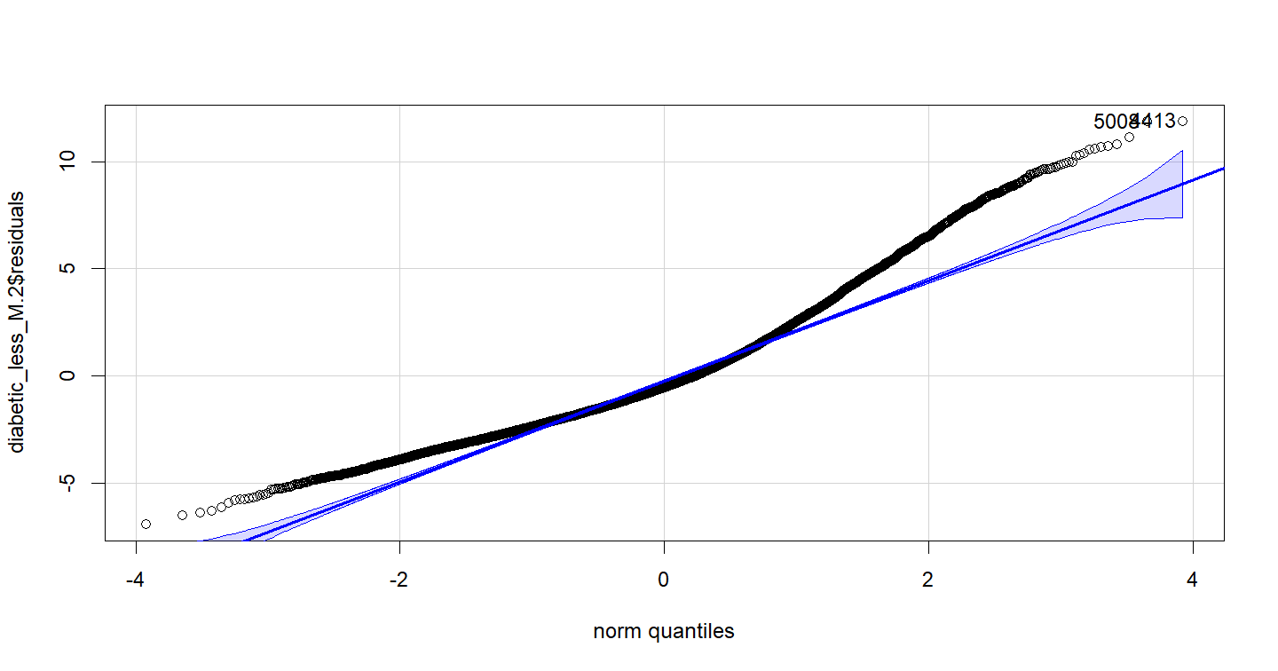
ANALYSIS OF RESIDUALS FOR Model 2 (contd.)
We test for normality of the residuals using qq-plot.
BUT!!! TOO MANY SAMPLES!!!
Formal test for normality Shapiro-Wilk test?

Slide 17
MULTICOLLINEARITY
The predictors must not be correlated. If the predictors are correlated and the estimation of regression coefficients gets affected → multicollinearity!

Slide 18
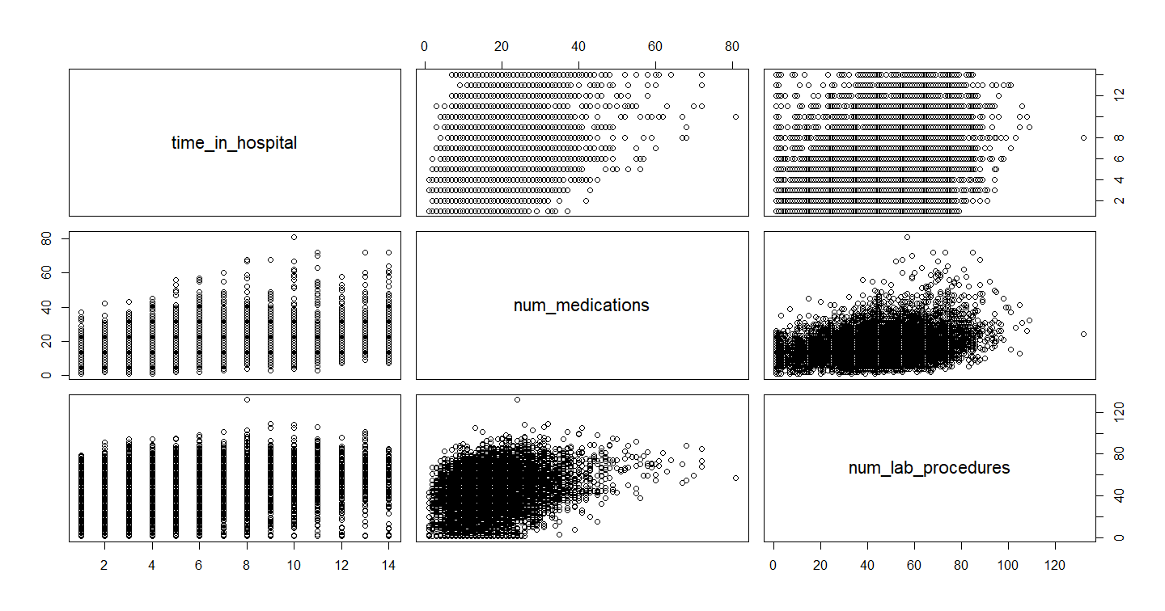

Slide 19
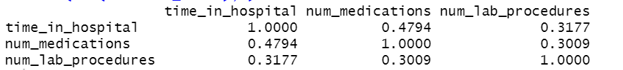

MULTICOLLINEARITY & variance inflation factor
We observe that the predictors number of medications and number of lab procedures are correlated.
Variance Inflation Factor (VIF):
VIF > 1 Hence, there is correlation among the predictors.

Slide 20
Conclusion
Our regression models 1 and 2 satisfy only one of the four conditions of the Gauss-Markov theorem – expectation of errors is zero
The residuals are correlated and display heteroscedasticity and are not normally distributed.
Since the number of samples is greater than 5000, the formal Shapiro-Wilk test cannot be performed on our data.
There is evidence of multicollinearity among the predictors used in regression model 2.
Variance Inflation Factor is obtained as 1.099.

Slide 21
THANK YOU

